Slide 1

Subject: Python for Computational Problem Solving (PCPS)
Subject Code: UE23CS151A
Mini Project
SEMESTER - I
POKEMON WITH PYTHON
Team details:
PES1UG23AM197 - Noel George Jose PES1UG23CS433 - Pranav Hemanth
PES1UG23CS435 - Pranav Rajesh Narayan
PES1UG23CS424 - Pragathi Panchangam
Under the guidance of,
Prof. Sowmya Shree P
Dept. of CSE PES University

Slide 2



With Python
Mini-Project Sem 1
PES1UG23AM197 Noel George Jose PES1UG23CS433 Pranav Hemanth
PES1UG23CS435 Pranav Rajesh Narayan
PES1UG23CS424 Pragathi Panchangam
Under the guidance of Professor Sowmya Shree P (Dept. of CSE PES University)

Slide 3
PROBLEM STATEMENT
To develop a Pokémon battle game that provides an immersive and strategic gaming experience for players, combining elements of skill, strategy, and creativity.

Slide 4
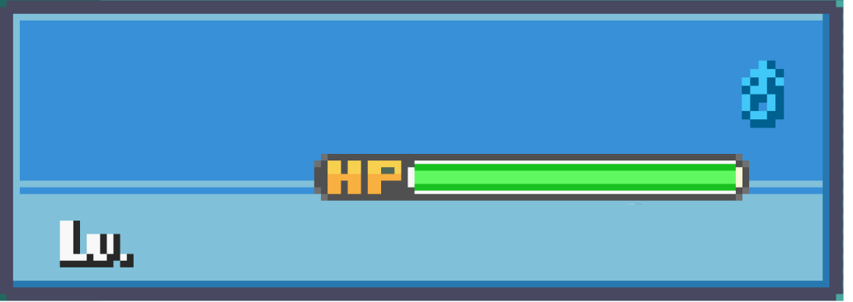

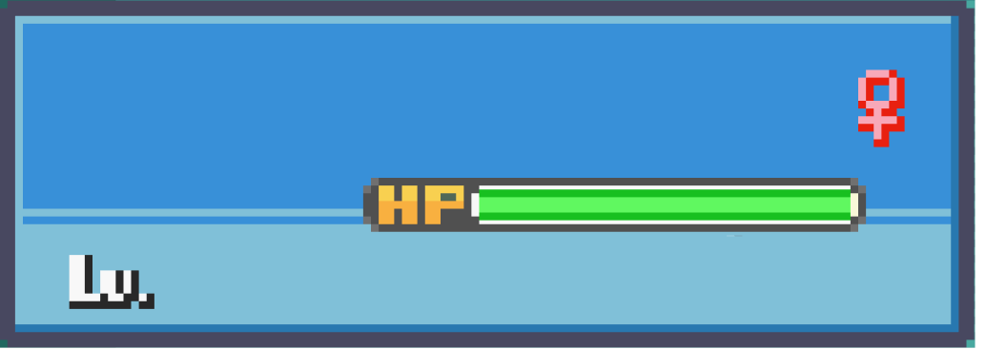
Team Members
Pranav H.
Pragathi
18
Game Logic
19
Graphic Design
Noel Jose
Pranav R.
18
GUI, Logic & Design
18
Game Logic
NEXT

Slide 5

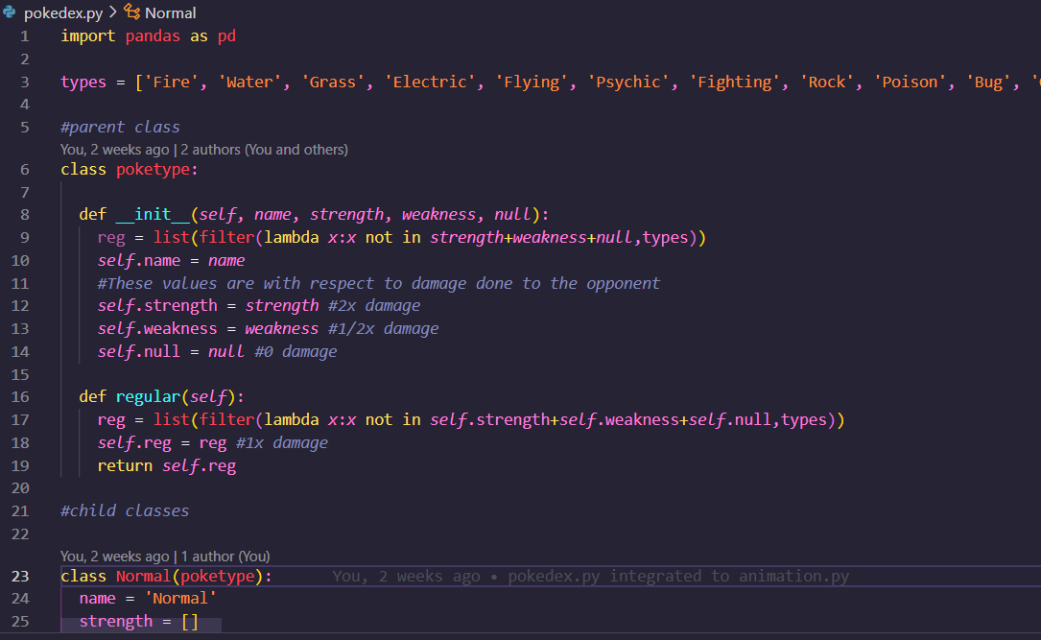
MODULES USED
CUSTOM MODULE
pygame (including sub-modules)
random
pandas
os
tkinter (including sub-modules)
functools
Custom module used: pokedex.py

Slide 6
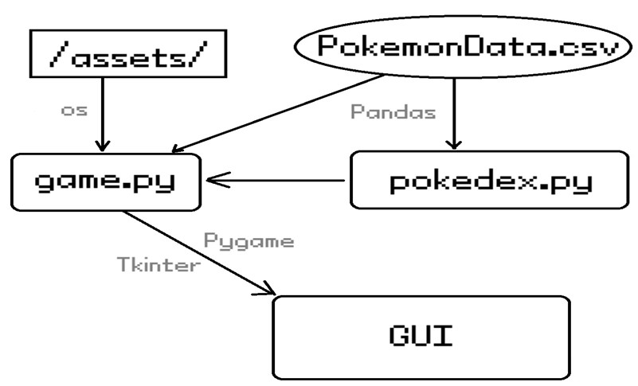
CONNECTION MAP
IMPLEMENTATION
The main game is run on one python file and uses values from a secondary python file imported as a module. It uses a mixture of pandas and random for data manipulation and assignment. We used pygame and tkinter for the GUI elements of the game. Os module is used to make the game function in any operating system.

Slide 7
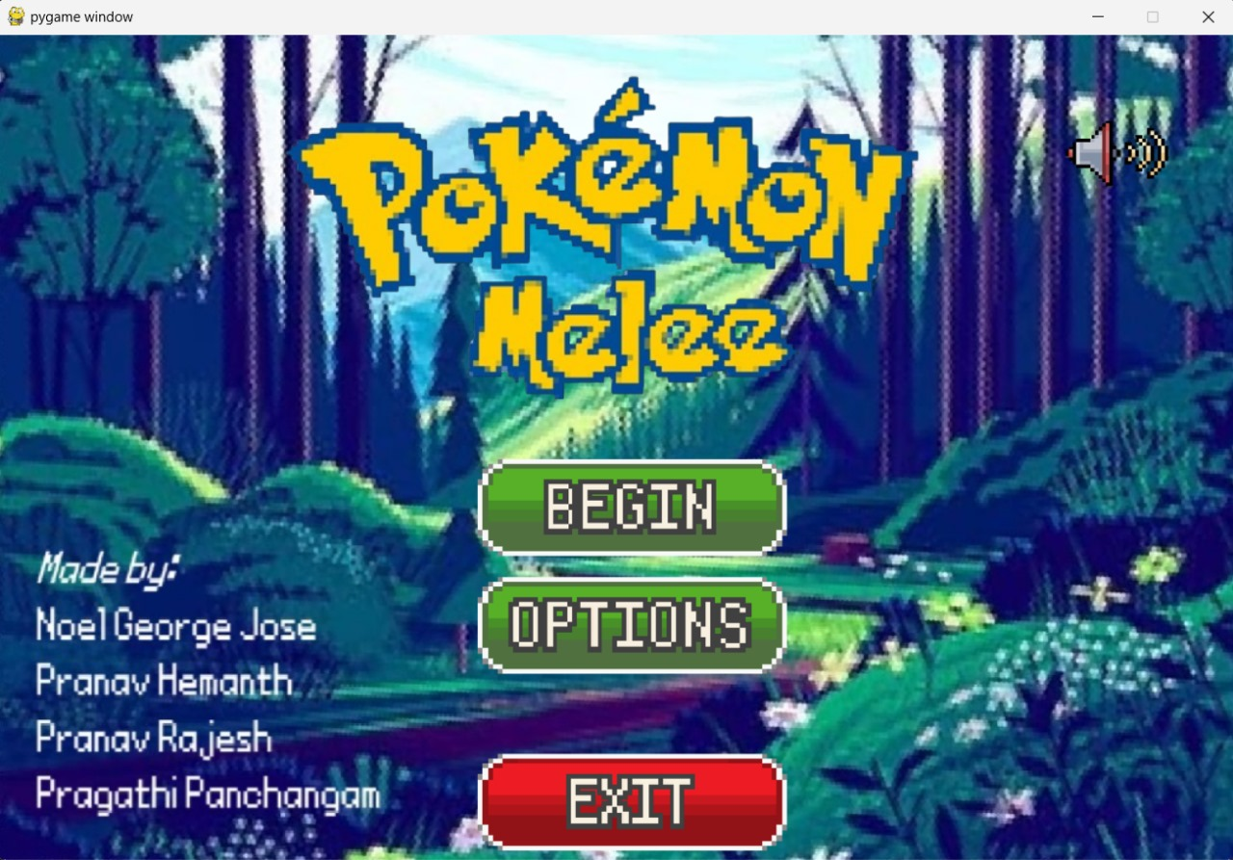
RESULTS & DISCUSSSION
HOMESCREEN
Begin: To start the game Options: To reset the game variables and set players names Exit: To close the game window Speaker: To toggle volume on/off

Slide 8
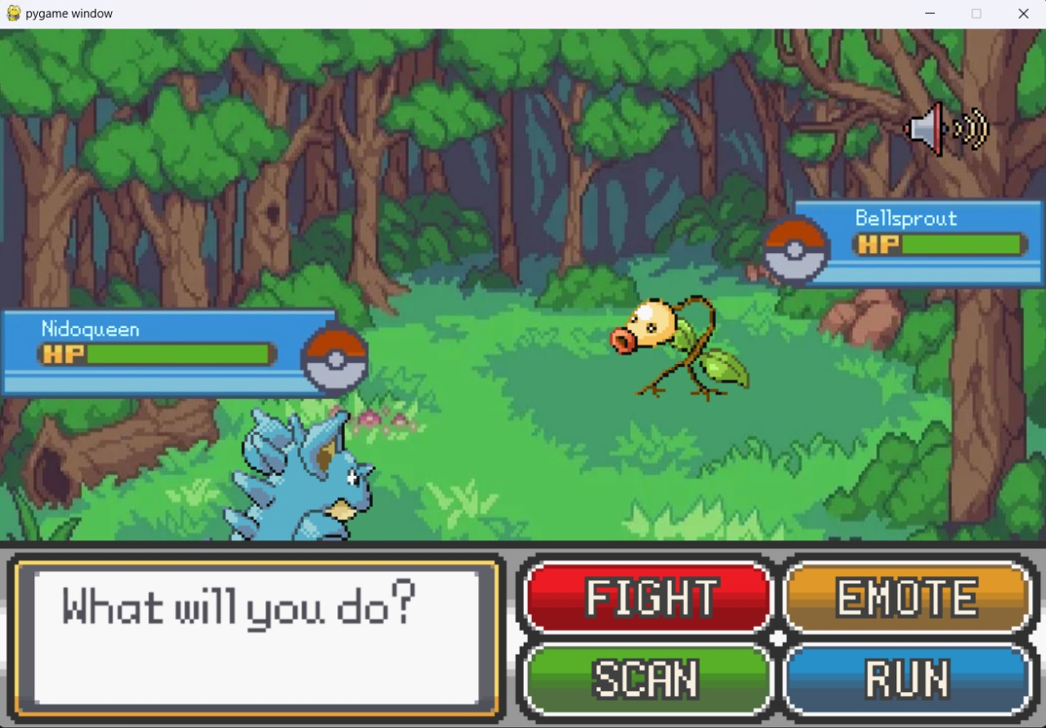
RESULTS & DISCUSSSION
BATTLE SCREEN
Fight Button: To show attacks, when clicked does damage
Emote Button: To emote
Scan: To show player name, Pokémon name, health and damage
Run button: To exit to home screen

Slide 9
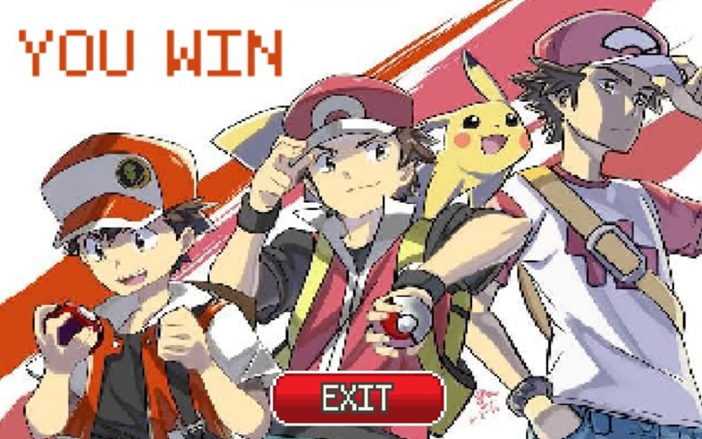
RESULTS & DISCUSSSION
END SCREEN
Displayed after the end of the game according to battle result
Exit: To redirect back to home screen

Slide 10
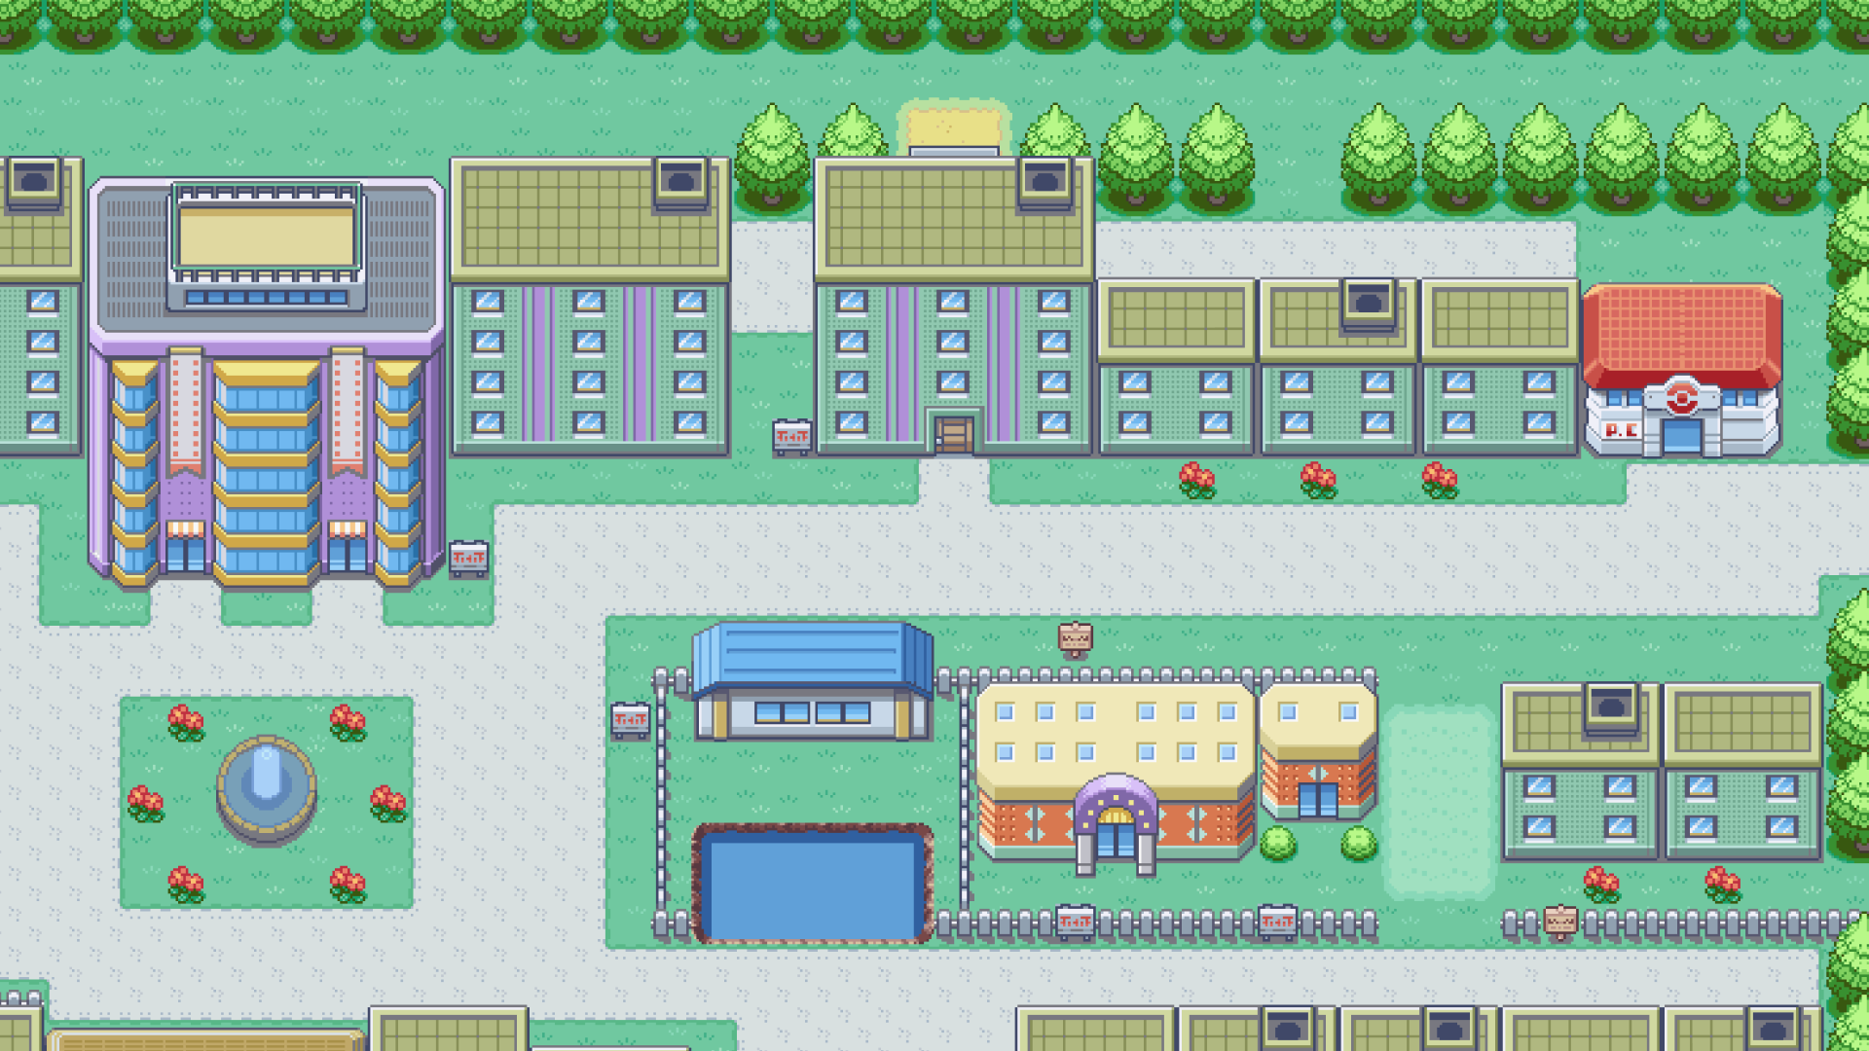
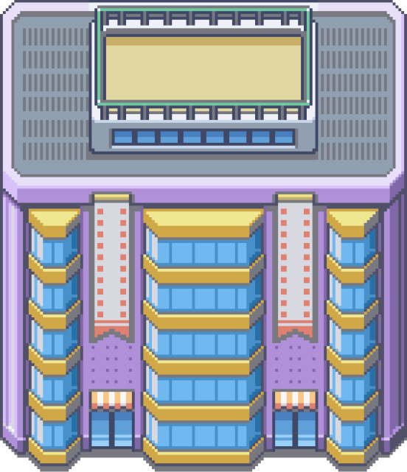





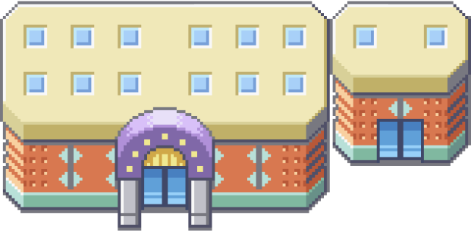
LEARNING FROM PROJECT

Slide 11
LEARNING OUTCOMES
GUI using pygame and tkinter
Database management using pandas and csv files
Object oriented programming using classes
Control flows
Working with functions and their types

Slide 12
CONCLUSION
Thus, we have created a Pokémon game using python and associated modules with it.

Slide 13
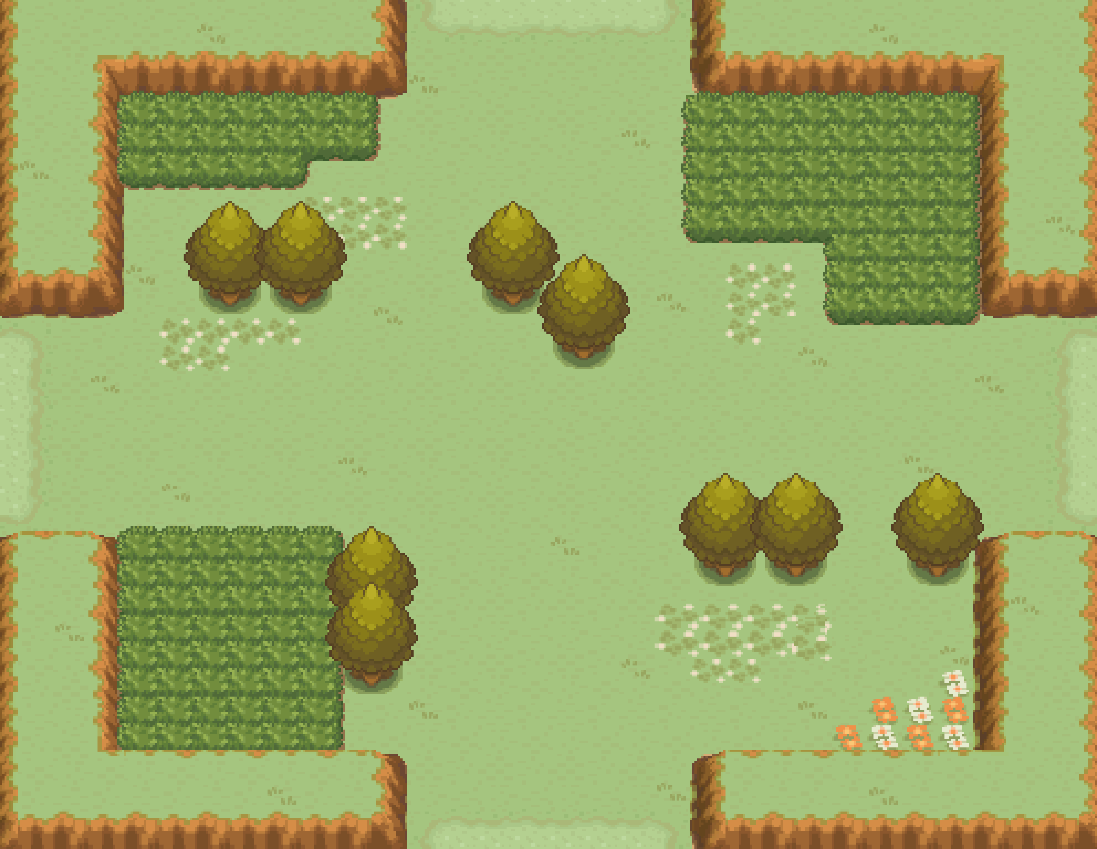











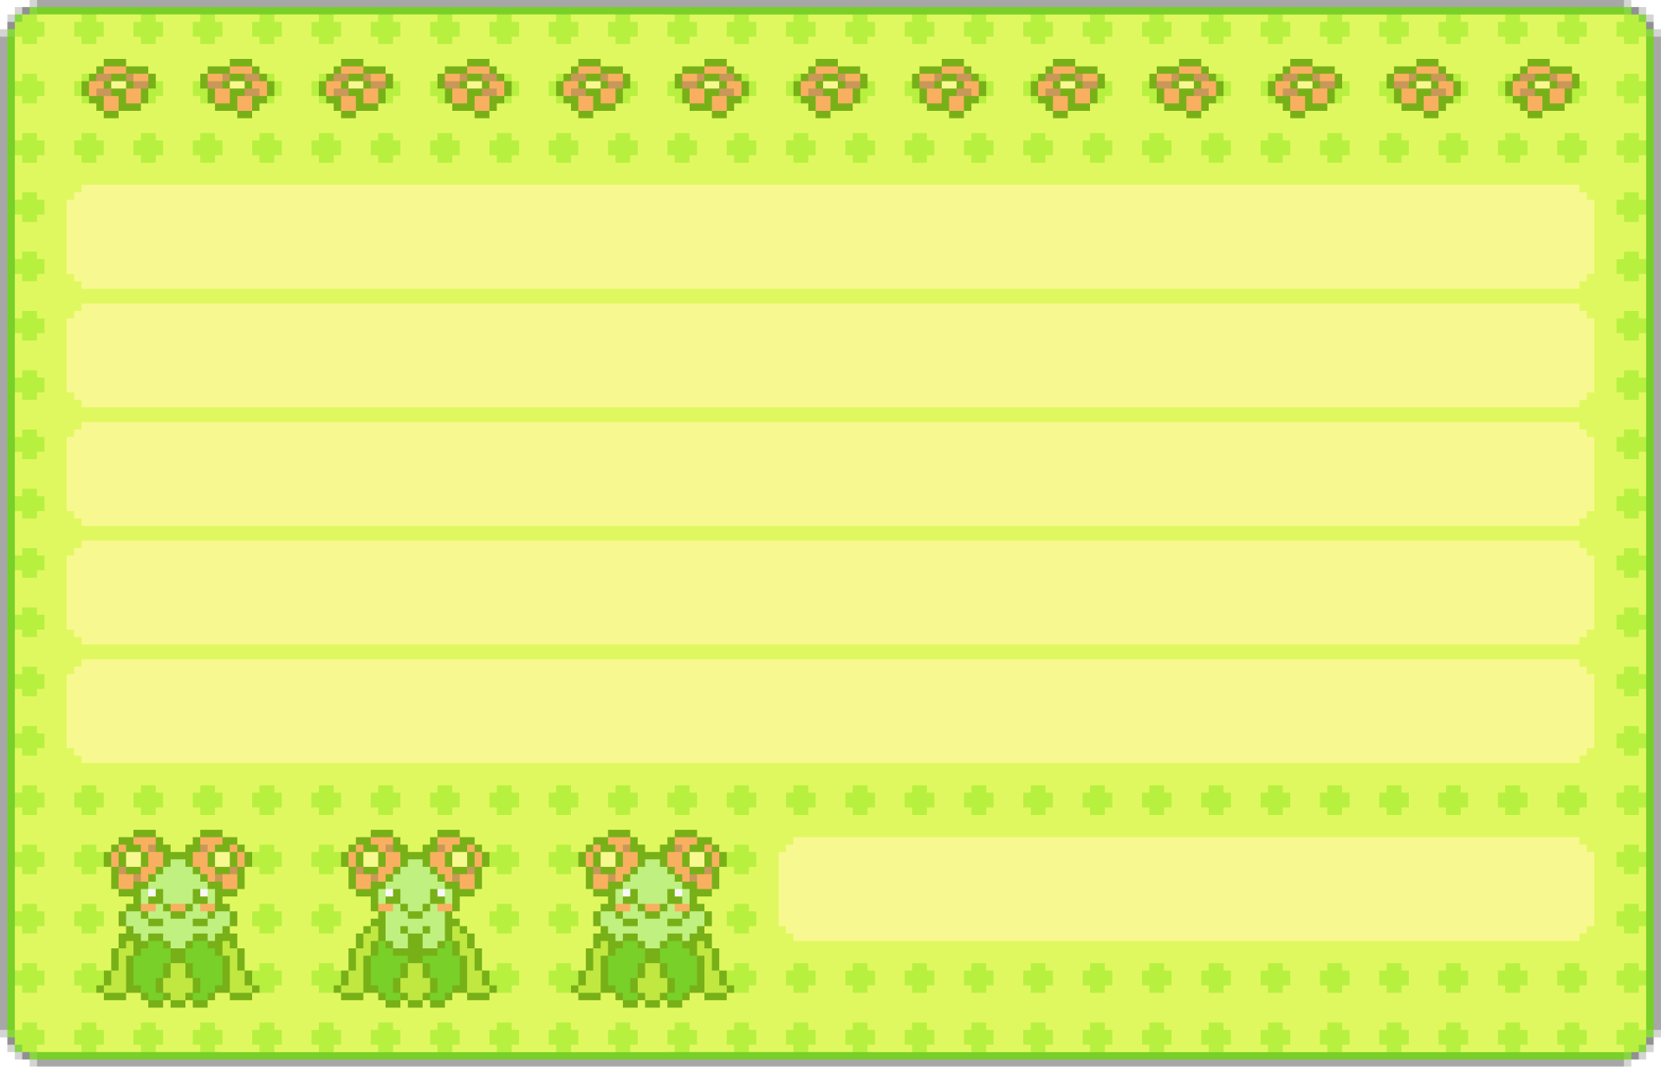
FUTURE WORK
Turn based combat & team battles
Team selection screen
Using Pokémon items
Faster and diverse battle animations
Campaign mode

Slide 14
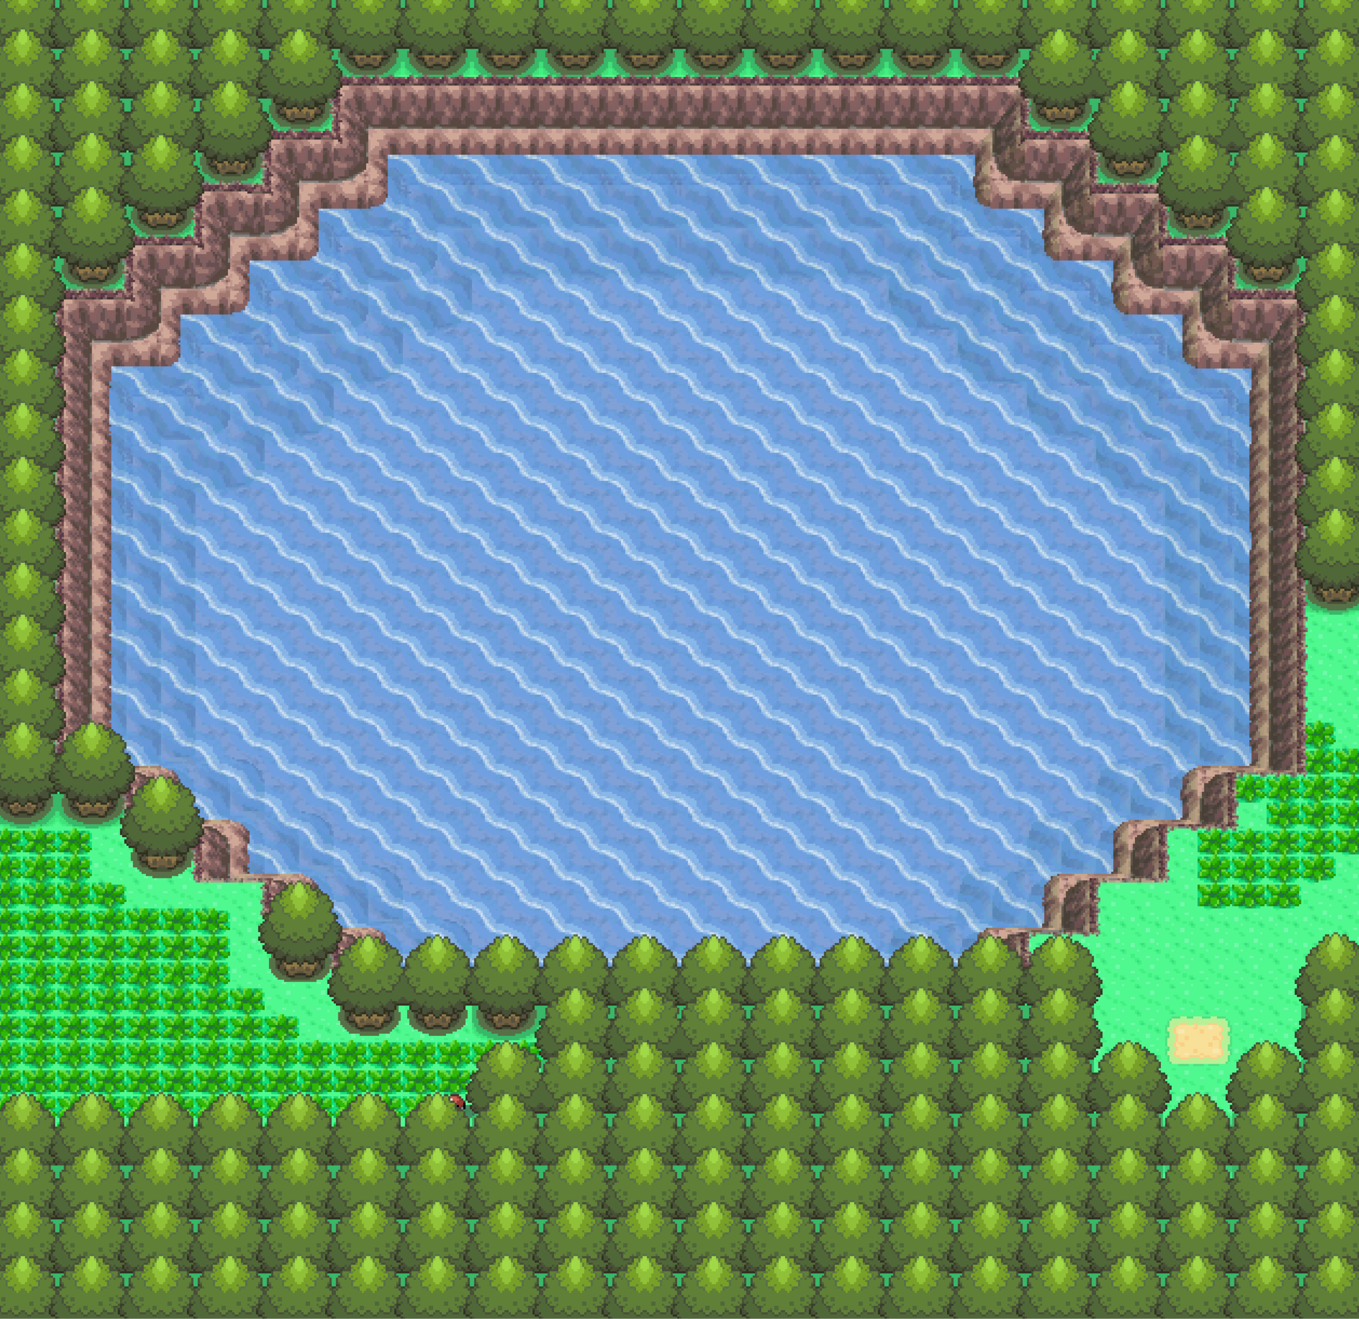






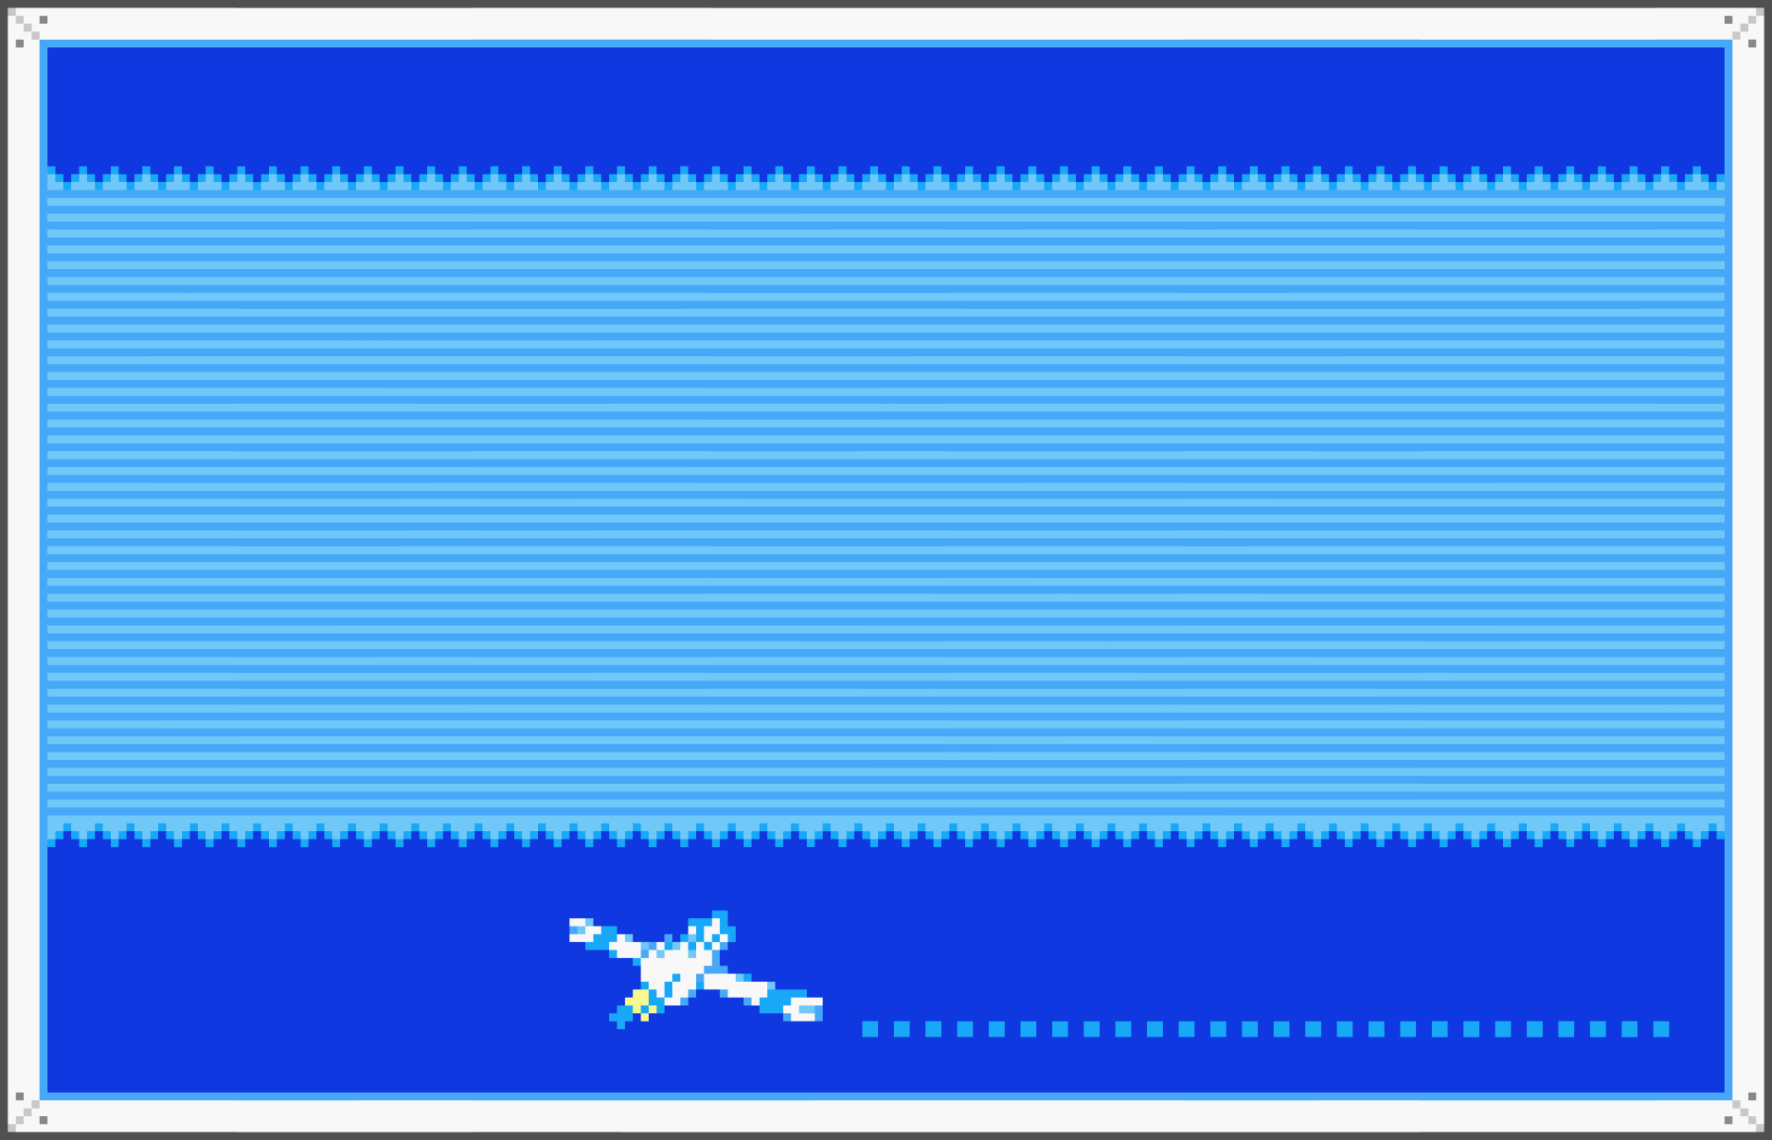
REFERENCES
[1] W3Schools [6] Tkinter documentation
[2] GeeksforGeeks [7] Sprites taken from PokeAPI
[3] stackoverflow and Pokémondb
[4] Pygame documentation [8] Home music by
[5] Pandas documentation Frank Tedesco

Slide 15



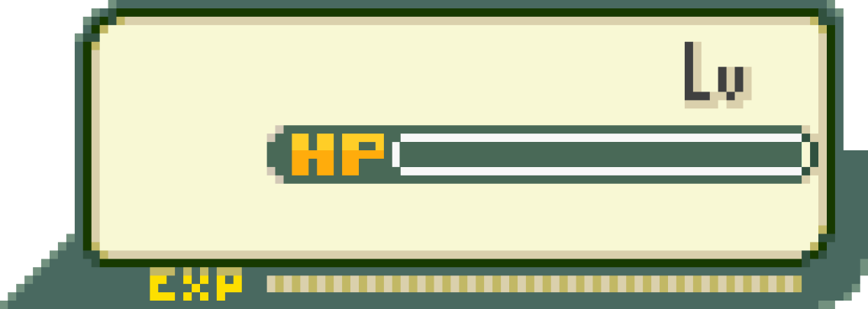
Which move will you pick?
GENGAR
3
Thank you!
NIDORINO
6
50/50
Fight
Emote
Scan
Run

